Slide 1
Users, Group, Guest policies, and Package Management
Mostly review, so make sure you know everything in here.

Slide 2
What two types of users are there in Ubuntu and Debian systems?
What are the differences
What possible vulnerabilities does that cause?

Slide 3
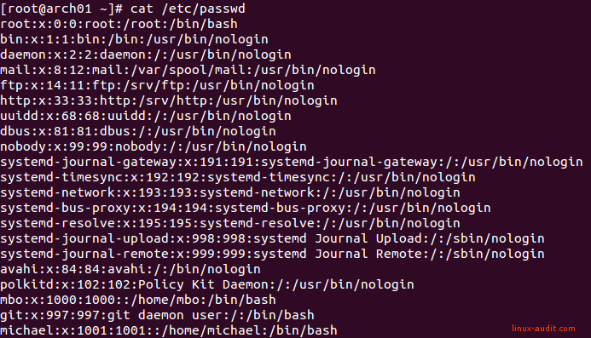
User notation: UID and other user info
What is the purpose passwd file?
What does each line mean?
Any important vulnerabilities in this file?

Slide 4
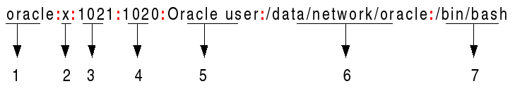
Passwd file in depth
Username
Password
What does x mean
UID
GID
Comment field
Full name etc
Home directory
Shell directory, does not have to be shell
Make sure that the shell is /bin/bash for users ONLY

Slide 5
Important UID Rules (should be review)
Any user with UID of 0 is root, make sure no other users besides user root should have UID of 0
Hidden users have an UID of < 1000

Slide 6
Adding users
We use the adduser command to add users through the terminal
another method that is a bit dirtier is adding the line in /etc/passwd file but that does not add a home directory or password

Slide 7
Configuring adduser.conf
Important configs
DHOME=[dir]
Sets the directory for all user home directories created by the command, default is /home
DSHELL=[shell]
Sets the shell for user, default is /bin/bash, if set to anything else you will have problems.
FIRST_SYSTEM_UID & LAST_SYSTEM_UID= 100 & 999 respectively
Only values these should ever be set to.
FIRST_UID & LAST_UID= 1000 & 299999 respectively
Only values these should ever be set to.
Everything in Linux is configurable
Everything can be made more secure
The configuration file is found at /etc/adduser.conf

Slide 8
One last config
in adduser.conf there is a config called SKEL
This is by default set to the directory /etc/skel
This is the skeleton directory for all NEW home directories
Contains default files like .bashrc
.bashrc: runs upon new terminal. Can set aliases here
To understand what I mean, create a file using touch in the skeleton directory
Now create a new user and look into their home directory.

Slide 9
Deleting users
We use the deluser command to remove users
We can also delete the line from the passwd file
deluser -group [group]
Equal to delgroup [group]
Removes a group
deluser --remove-home [user]
Removes home directory as well as deleting user
deluser --remove-all-files [user]
Removes ALL files owned by user on the system

Slide 10
Configuring deluser.conf
Just like adduser, deluser also has a config file
Located at /etc/deluser.conf
Here are some important configs and their default values
REMOVE_HOME=0
0 - do not remove home by default
1 - do delete home by default
REMOVE_ALL_FILES=0
0 - do not remove files by default
1 - do delete files by default

Slide 11
Changing passwords
passwd -l [user]
Locks user account, no one can log in to that account
Lock everyone who isn’t on the readme because those people should not be allowed to log in
passwd -u [user]
Unlock user account
passwd -S [user]
Show user status
passwd -Sa [user]
Show all user status’
To change passwords, we use the passwd command as a system admin

Slide 12
Shadow File
What is the purpose of this file?
How does this relate to the passwd file
What useful information can we obtain from the shadow file?

Slide 13

Understanding the shadow file
Username
13-char encrypted password
Last password change
Minimum days for a password
Maximum days for a password
When the account user is warned about password age
Future field, how many days after password expiration that account is disabled
Future field, date when account will expire, counted from Jun 1, 1970

Slide 14
More about the shadow file
$1$TDQFedzX$.kv51AjM.FInu0lrH1dY30
The beginning of the encrypted password indicates the hash
$1$ is MD5
$2a$ is Blowfish
$2y$ is Blowfish
$5$ is SHA-256
$6$ is SHA-512

Slide 15
Changing shadow file parameters
chage is used to modify these parameters on a per user basis
Used like this
chage [options] username
chage -m 6 [user]
Changes min days of user to 6
chage -M 15 [user]
Changes max days of user to 15
chage -W 7 [user]
Warn days
chage -I 5 [user]
Inactive days

Slide 16
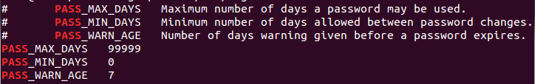
Changing shadow files parameters
Global settings can be set globally by editing /etc/login.defs

Slide 17
Pluggable Authentication Module
Controls password authentication for most applications
/etc/pam.d/ contains all the configuration for all pam
sudo apt install libpam-cracklib
Installs a PAM module that helps us ensure new passwords are secure, we’ll go over how to use this

Slide 18
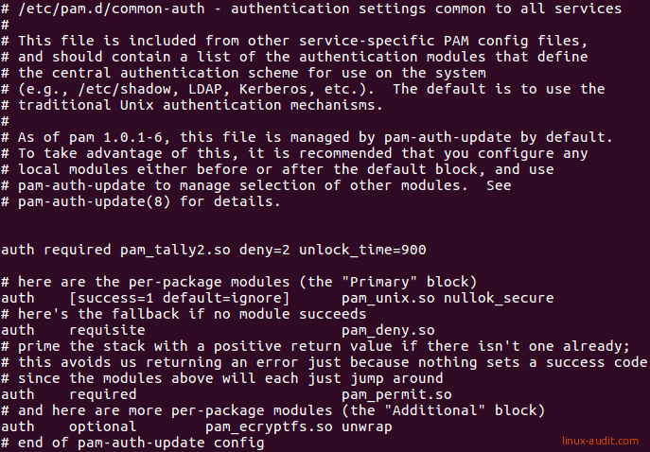
Common-auth
/etc/pam.d/common-auth
This file sets the authentication settings common to all applications, hence the name

Slide 19
Common-auth
Here is a sample configuration for the common-auth, it is long so we will go over the important configurations:
auth optional pam_tally.so deny=5 unlock_time=900 onerr=fail audit even_deny_root_account silent
deny=5
Deny user if attempts exceed 5
unlock_time=900
Locks user out for 900 seconds attempts exceed the amount defined
audit
Logs account into syslog if attempts exceed the amount defined
even_deny_root_account
Locks the root account, can’t login with root
Note: never have the line “nullok” or even “nullok_secure”. Think about what null means and what ok means
Notes:
Explain how to identify and edit the lines

Slide 20
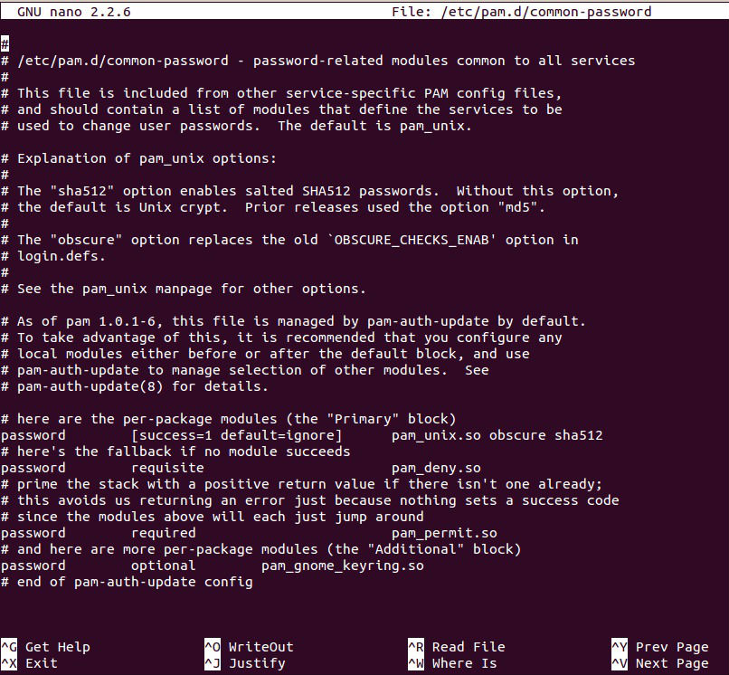
Common-password
/etc/common-password
This file controls how passwords are created, set, stored, and recalled throughout the system.

Slide 21
Common-password
There are two important lines we must edit, here are their configurations
password requisite pam_cracklib.so retry=3 minlen=8 difok=3 reject_username minclass=3 maxrepeat=2 dcredit=-1 ucredit=-1 lcredit=-1 ocredit=-1 gecoscheck enforce_for_root
retry=3
allow three attempts at a good password before the passwd program shuts down
minlen=8
Minimum password length of 8
difok=3
Sets the amount of characters that must be different from the last password
Reject_username
Reject username as password
minclass=3
Minimum types of characters that must be used
maxrepeat=2
Maximum number of repeating characters
Notes:
Explain how identify the lines

Slide 22
Common-password
There are two important lines we must edit, here are their configurations
password requisite pam_cracklib.so retry=3 minlen=8 difok=3 reject_username minclass=3 maxrepeat=2 dcredit=-1 ucredit=-1 lcredit=-1 ocredit=-1 gecoscheck enforce_for_root
gecoscheck:
Some fields are optional, like full name, number, address, etc. in adduser
Don’t allow these to show up in the password
enforce_for_root
Root must obey password policies
Notes:
Explain how identify the lines

Slide 23
Common-password
lcredit
lowercase
ucredit
uppercase
dcredit
digits
ocredit
Alphanumeric characters, !?>< etc.
This assigns value to types of characters, negative value means that they are required

Slide 24
Common-password
There are two important lines we must edit, here are their configurations
password sufficient pam_unix.so use_authtok obscure rounds=80000 sha512 shadow remember=7
obscure
Extra password checks, you can google them if you want.
sha12
Encrypt passwords with SHA12
rounds
number of rounds of encryption
remember=7
Remember the last 7 passwords to prevent alternating passwords too often
Notes:
Explain how identify the lines

Slide 25
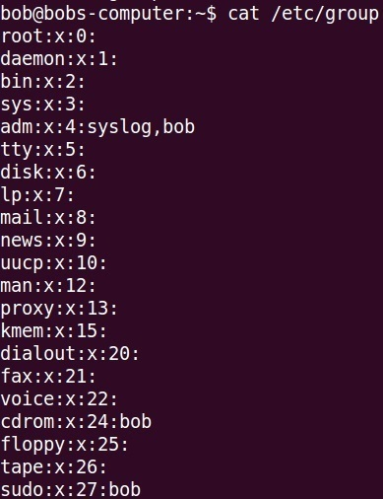
The group file
Similar to the passwd file
Both in etc
What does control? What important groups are there?

Slide 26
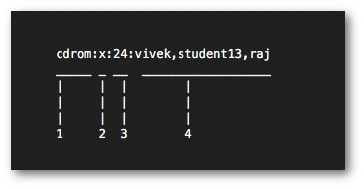
Group file in depth
Group name
Password
GID
Users in group

Slide 27
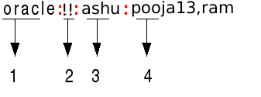
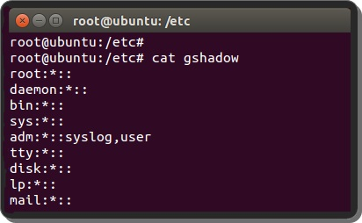
How to configure groups
Groups have passwords and administrators
/etc/group does not actually show these, to see group admins and encrypted group passwords you must look at /etc/gshadow
Group name
Group password
!! no pass
Group admin(s)
Regular users
members [group]
Returns all members of a group
might have to install members, but it’s a nice cmd

Slide 28
How to configure groups
To edit group properties, we use the gpasswd command to edit admins, group passwords, and regular users
gpasswd [group]
Prompts for new password when called by group administrator
gpasswd -a [user]
Add a regular user to group
gpasswd -A [users,users2]
Set administrator list
gpasswd -d [user]
Remove a user from group

Slide 29
Sudoers file
What is the importance of this file?
How do we safely edit this file?
What other directories does this file include per se?

Slide 30
What to look for in the sudoers file
Always edit with the visudo command
Visudo checks the file with basic sanity checks, makes sure the file saves correctly otherwise you cannot use administrative privileges
Any user with [username] ALL=(ALL:ALL) ALL
Instances of NOPASSWD
Instances of Defaults !authenticate
/etc/sudoers.d/
Any file can have these lines INCLUDING THE README
Use ls -al to look for files with blank names

Slide 31
What is LightDM?
LightDM is our Display Manager for Ubuntu v16.04 and below
For newer versions of Ubuntu we use GDM
LightDM launches our X servers, greeter (Login screens), and user sessions
Default greeter is Unity Greeter
We are concerned with the greeter

Slide 32
Configuring LightDM
LightDM configurations are stored in three places
/usr/share/lightdm/lightdm.conf.d/*.conf
/etc/lightdm/lightdm.conf.d/*.conf
/etc/lightdm/lightdm.conf
First location is restricted and only for the system, we don’t edit that one
Second location is editable and we may choose to edit this file
Third location is editable and preferable to edit.

Slide 33
Configuring LightDM
LightDM combines the configurations at the end
Let’s pick /etc/lightdm/lightdm.conf
Here are some important configs
allow-guest=false
greeter-hide-users=true
Hides the users list, the list of users shown at login. Explicitly declare manual login below
greeter-show-manual-login=true
Shows the manual login

Slide 34
Package management
What is our main package managers? What commands can we use to install/remove packages?
How are they different? What makes us choose one over the other?
What is a repo?
Where are repos stored?
How do we edit repos?

Slide 35
Apt Basics
Apt is short for Aptitude
apt vs apt-get
Apt command is supposed to be “More pleasant for end user”
Recommended to use apt over apt-get.
Do not confuse apt for dpkg
Apt handles packages from internet repos, while dpkg simply installs .deb files.
Apt downloads the deb file in a package, and installs it with dpkg.

Slide 36
Apt options
apt install [packagename]
Install package
apt update
Updates package index, defined by your repos in sources.list and sources.list.d
apt upgrade
Install updates to packages from the APT package index. (we’ll cover what this is soon.)
apt remove [packagename]
Remove packages

Slide 37
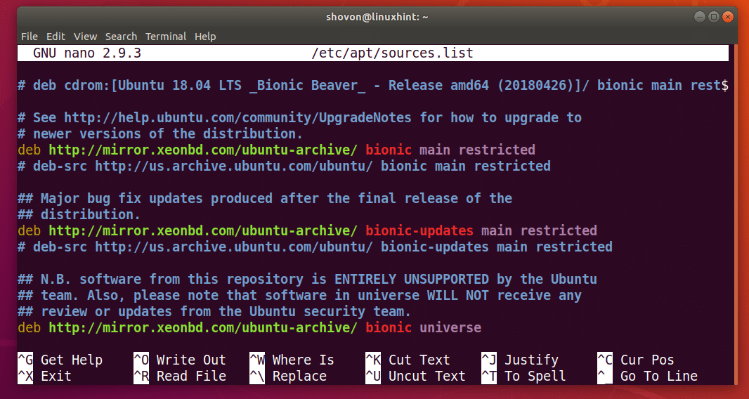
Repositories
Ubuntu stores its repos in the /etc/sources.list and corresponding files in /etc/sources.list.d/
Repos control your APT package index

Slide 38
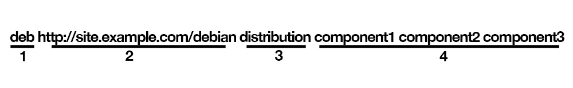
Understanding the sources.list file
Type of repo
deb is user packages
deb-src is source code
Location of repo
Ubuntu version
Ubuntu 16.04 is xenial
Section name, or component

Slide 39
Adding and removing repos
add-apt-repository [repo]
A full line in quotes will append to the sources.list
add-apt-repository ppa:[developer]/[ppaname]
This adds a Personal Package Archives to your package index
This is unsupported software, be wary of what you add.

Slide 40
Apt settings
/etc/apt/apt.conf.d/20auto-upgrades:
APT::Periodic::Update-Package-Lists "1";
APT::Periodic::Download-Upgradeable-Packages "1";
APT::Periodic::AutocleanInterval "7";
APT::Periodic::Unattended-Upgrade "1";
This is the same thing as doing apt thru GUI settings
dpkg-reconfigure -plow unattended-upgrades

Slide 41
Services, Processes, and Logging
Hello there

Slide 42
How to start, stop, and restart services
There are multiple commands that can control services, the two main commands are service and systemctl
We are gonna go over service
service [service] start
Starts a service
service [service] stop
Stops a service
service [service] restart
Restarts a service
Service --status-all
Lists the status of all services

Slide 43
More about the service command
The service command works by calling a script in the /etc/init.d/ directory
This directory holds many scripts that control services like apache and sshd
service apache2 stop equals /etc/init.d/apache2 stop

Slide 44
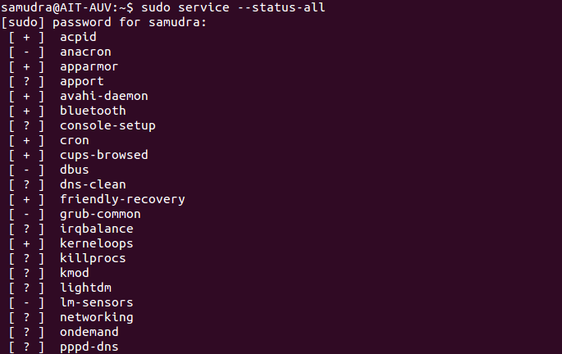
Reading service status’
The output from the command service --status-all can be confusing to read
[+]
Means the service is running
[-]
Means the service is not running
[?]
Means the service is not responding to the query, the service isn’t sending anything back when asked if running.

Slide 45
How to view running processes
There are a couple ways to view running processes
Each one is useful for different purposes
ps aux
Outputs a snapshot of running processes, good to pipe into grep or less
top
Outputs live running processes, updating in real time. Good for managing cpu usage and memory management
htop
Better version of top, not usually installed
pgrep [process]
Returns process ID

Slide 46
How to kill processes
Just like viewing processes, killing processes is done in a variety of ways
kill [PID]
Kills process using process id, Useful when you want to kill a single very specific process
killall [process]
Kills all processes that match name

Slide 47
Logging in Ubuntu
Important System Logs
/var/log/auth.log
Logs all authentication related information, anything with PAM
/var/log/daemon.log
Logs all things to do with daemons, background processes, useful for troubleshooting certain daemons
/var/log/syslog
Contains a great deal of information from various parts of the system, refer to this when you can’t find what you want in other logs.
System logging is an important part of auditing a Ubuntu system.
System logs are stored in /var/log/
These files have many lines, it is generally recommended to use grep to cut down on the sheer volume

Slide 48
Application Logs
Example Application Logs
/var/log/apache2/access.log
Logs all pages and files served by the server
/var/log/apache2/error.log
Logs all errors reported by the server
/var/log/samba/log.[IP_ADDRESS]
Logs various samba requests from that IP
Many applications log in the /var/log/ directory as well

Slide 49
Un-readable logs
Some logs are not cat-able, and have special commands.
faillog
Shows login failures log
lastlog
Shows listing of logins, use with less

Slide 50
Firewall configuration

Slide 51
UFW in Ubuntu
ufw enable
Enables firewall and enables firewall on boot
ufw disable
Disable firewall and disable firewall on boot
ufw default allow|deny|reject [incoming|outgoing|routed]
Sets the default for all incoming, outgoing, or routed packets (depending on option) to allow, deny, or reject (depending on the option)
ufw reject [args]
Reject any packet following these arguments (We will go over args in next slide)
ufw allow [args]
Allow any packet following these arguments (We will go over args in next slide)
ufw deny [args]
Deny any packet following these arguments (We will go over args in next slide)
ufw logging [on|off]
Enables logging, logs can be found at /var/log/ufw.log
UFW stands for Uncomplicated Firewall, and is the main firewall tool in Ubuntu.
UFW has a GUI but that’s disgusting. WE USE THE COMMAND LINE.

Slide 52
Valid UFW Arguments
Example arguments
24/tcp
This is a port number and a protocol
sshd
A service name
apache2/udp
A service name and a protocol
When deny,rejecting or allowing packets, there are various different valid arguments.

Slide 53
Deny, reject, and allow
Deny means do not allow that package to travel in the specified direction (incoming,outcoming). Default direction is incoming
Reject means do not allow that package to travel in specified direction and inform the sender that the packet was rejected
Allow means do allow that packet to travel.

